Slide 1
Module 1
Personal documents used at work

Slide 2


Module 1
Click on the arrow to see the following information.
Purpose
Students will develop theoretical and practical knowledge to write documents used in the working context: Reference letters, application letter, curriculum vitae, resume, request letter and complain letter.
Jonathan: Integrar imagen de acuerdo al texto.

Slide 3
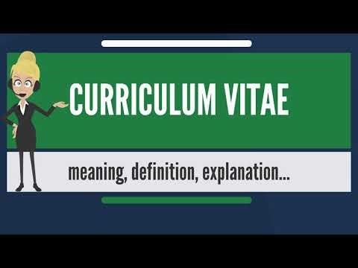
Module 1
Generating ideas
We all know how to write documents in our native language and we also know what expressions or vocabulary to use when we write. We can write reference letters, curriculum vitae, request land complain letters, however, do we know how to write them in English? It is very important to know what expressions, vocabulary and what format can be used in each case. The reason? In English these documents /papers have to be written in a different way. Let's see an example:
Watch the attached video and answer these questions:
1. According to the video what is a curriculum vitae (CV)?
2. How long is a CV in the United Kingdom?
3. What does the CV contain?
4. When is the CV generally used?
5. When is the resume generally used?
https://www.youtube.com/watch?v=1a9vZG8iPN8

Slide 4

Module 1
Course content
Click on each tab to see its contents.
Renato: título de sección
1.1. Reference Letter
Renato: título de primer apartado de esta sección.
1.1.1. What is a Reference letter?
Renato: contenido de primer apartado de esta sección.
Click the Start button to see the content of the following presentation, there you can find what a reference letter is and some recommendations for writing this type of documents are also included.
A reference letter also called a recommendation letter is a document in which someone gives evidence of knowing a person’s skills, character, work experience and achievements. When a person applies for any job a reference letter will be required. Some authors recommend that in order to write an effective reference letter, you must be familiar enough with the applicant’s abilities and performance to offer an evaluation, and you must keep in mind the following:
Identify yourself by name, title or position, employer, and address.
Respond directly to the inquiry, carefully addressing the specific questions asked.
Address specifically the applicant’s skills, abilities, knowledge, and character, guided by the person’s résumé when possible.
Communicate truthfully and without embellishment.
These letters may be written by current or former supervisors, co-workers, customers, or other business professionals who have first-hand knowledge about the applicant.
(Adapted from Alred, G. et al, 2009, p. 449).
Aurelio: elaborar presentación con esta información.

Slide 5
Renato: título del segundo apartado de esta sección.
1.1.2. Reference letter do’s and don’t
Renato: contenido del segundo apartado de esta sección.
Reference letter do’s and don’t
Do’s | Don’ts
Do choose someone who knows you well enough to give you a recommendation. Do get recommendations from employers, professors, school administration, and anyone else who has first-hand knowledge of your work experience and qualifications. Do ask for the recommendation in person, rather than sending an email. Do tell the letter writer why you need the reference letter. Do mention specific experience, qualifications, and skills that you would like included in the letter. Do send “thank you” notes, afterwards to the people who wrote reference letters. Do ask permission to keep copies of the letters in case you need to use them again in the future. | Don’t wait until the last minute. Secure reference letters as soon as possible. Don’t ask someone to provide false or second-hand information. Don’t ever forge signatures. Don’t choose someone to be a reference because of his/her title. Choose someone who can verify firsthand how your experience, skills, and abilities qualify you for the job. Don’t hesitate to get as many reference letters as possible. Submit the letters that best describe why you are qualified for the position. Don’t forget to say “please” and “thank you.” A reference and his/her recommendation are valuable resources.
Aurelio: dar formato interactivo a este cuadro comparativo.
Adapted from: Sampletemplates (2021).

Slide 6
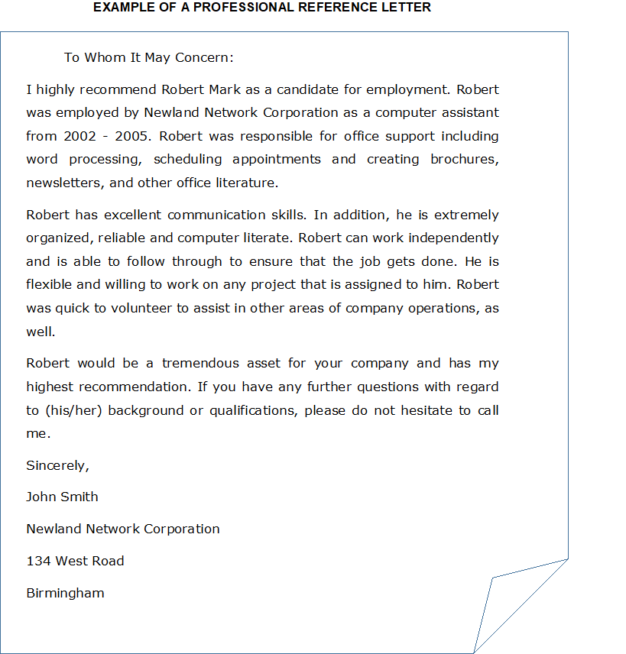
Renato: título del tercer apartado de esta sección.
1.1.3. Example of a reference letter
Click each icon to identify the basic elements of a reference letter.
Renato: contenido del tercer apartado de esta sección.
Aurelio: recrear esta imagen para presentarla como imagen guiada. En documento anexo te comparto el esquema completo que realizaron las maestras.
Taken from: Sampletemplates (2021).

Slide 7
Module 1
Click on each tab to see its content.
Renato: título de sección
1.2. Aplication letter
1.2.1. What is an application letter?
Renato: título del primer apartado de esta sección
Click the Start button to see the content of the following presentation, there you can find what an application letter is and some recommendations for writing this type of documents are also included.
Renato: contenido del primer apartado de esta sección.
According to Alread et al. (2009) the application letter is essentially a sales letter in which you market your skills, abilities, and knowledge. Therefore, your application letter must be persuasive. The successful application letter accomplishes four tasks:
1. It catches the reader’s attention favorably by describing how your skills will contribute to the organization,
2. It explains which particular job interests you and why,
3. It convinces the reader that you are qualified for the job by highlighting and interpreting the particularly impressive qualifications in your résumé, and
4. It requests an interview
Application letter checklist:
Here there are some other important considerations to take into account:
1. Identify the job by title and let the recipient know how you heard about it.
2. Summarize your qualifications for the job, specifically your work experience, activities that show your leadership skills, and your educational background.
3. Refer the reader to your enclosed resume.
4. Ask for an interview, stating where you can be reached and when you will be available. If your prospective employer is located in another city and you plan to visit the area, mention the dates for your trip.
5. If you are applying for a specific job, include any information pertinent to the position that is not included in your resume.
To save your reader time and to call attention to your strengths as a candidate, state your objective directly at the beginning of the letter.
Aurelio: elaborar presentación con esta información.

Slide 8
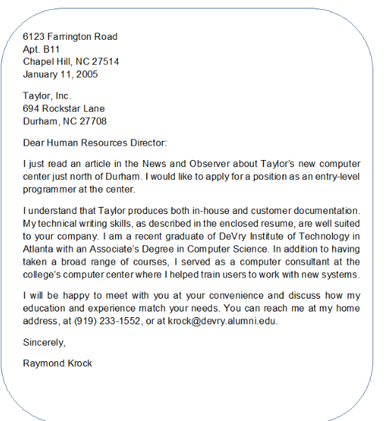
Module 1
Renato: título del segundo apartado de esta sección
1.2.2. Example of an Application Letter
Click each icon to identify the basic elements of an application letter.
Renato: contenido del segundo apartado de esta sección.
Aurelio: recrear esta imagen para presentarla como imagen guiada. En documento anexo te comparto el esquema completo que realizaron las maestras.
Taken from: The writing Center (s. f.).

Slide 9
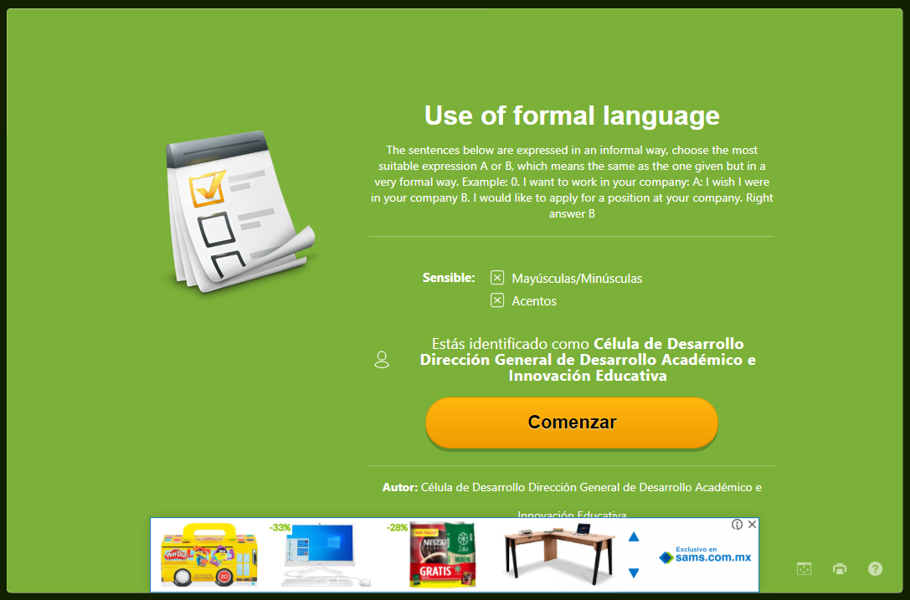
Module 1
Renato: título de sección
1.3. Exercise: reference letter and application letter
Click on each tab to see its content.
Renato: título del primer apartado de esta sección
1.3.1. Activity: Use of formal language
The sentences below are expressed in an informal way, choose the most suitable expression a or b, which means the same as the one given but in a very formal way.
Example:
I want to work in your company:
a. I wish I were in your company
b. I would like to apply for a position at your company.
Right answer: b
Renato: contenido del primer apartado de esta sección.
Click the Start button to do the activity. Remember that the score you get in this activity is not considered for your course final grade.
Jonathan: revisa el test en educaplay, lo elaboré con base en el esquema de preguntas y respuestas que enviaron las maestras.
https://es.educaplay.com/recursos-educativos/12521878-use_of_formal_language.html

Slide 10
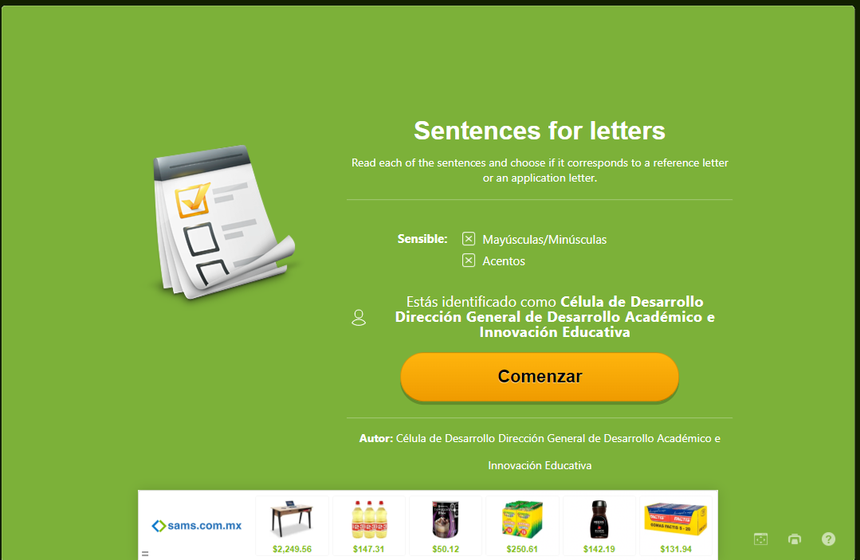
Module 1
Renato: título del segundo apartado de esta sección
1.3.2. Activity: Reference letter or application letter
Read each of the sentences and choose if it corresponds to a reference letter or an application letter.
Click the Start button to do the activity. Remember that the score you get in this activity is not considered
for your course final grade.
Renato: contenido del segundo apartado de esta sección.
Jonathan: revisa el test en educaplay, lo elaboré con base en el esquema de preguntas y respuestas que enviaron las maestras.
https://es.educaplay.com/recursos-educativos/12522244-sentences_for_letters.html

Slide 11
Module 1
Click on each tab to see its content.
Renato: título de sección
1.4. Curriculum vitae and resume
Renato: título del primer apartado de esta sección
1.4.1. What is a Curriculum vitae?
Click the Start button to see the content of the following presentation, there you can find what a curriculum vitae is and some recommendations for writing this type of documents are also included.
Renato: contenido del primer apartado de esta sección
Curriculum vitae
A curriculum vitae often called a CV for short, it's much more comprehensive than the typical resume and can be much longer.
There's no limit to how long a CV can be, but it must be focused on academic and professional experience. A lengthy CV isn't any better than a short one if it contains fluff or irrelevant data.
A CV begins with your contact information, including your name, address, telephone number, and email address. You should also indicate your area or areas of academic interest.
Your CV should include a comprehensive account of your academic history, including the title of your dissertation or thesis. It must also contain details about all publications, research projects, and presentations to which you have contributed. You should also list any grants, academic awards, and other related honors you've received.
The employment and experience section of your CV should contain teaching and research positions, both paid and unpaid. In addition to jobs, include any relevant internships and volunteer experiences here. Following that section, discuss memberships in scholarly and professional associations and include offices you have held, if any.
Finally, provide a list of references, along with their contact information, on your curriculum vitae. Doing this is in contrast to a resume, which never contains this information.
(Adapted from Alred, G. et al, 2009, p. 471).
Aurelio: elaborar presentación con esta información.

Slide 12
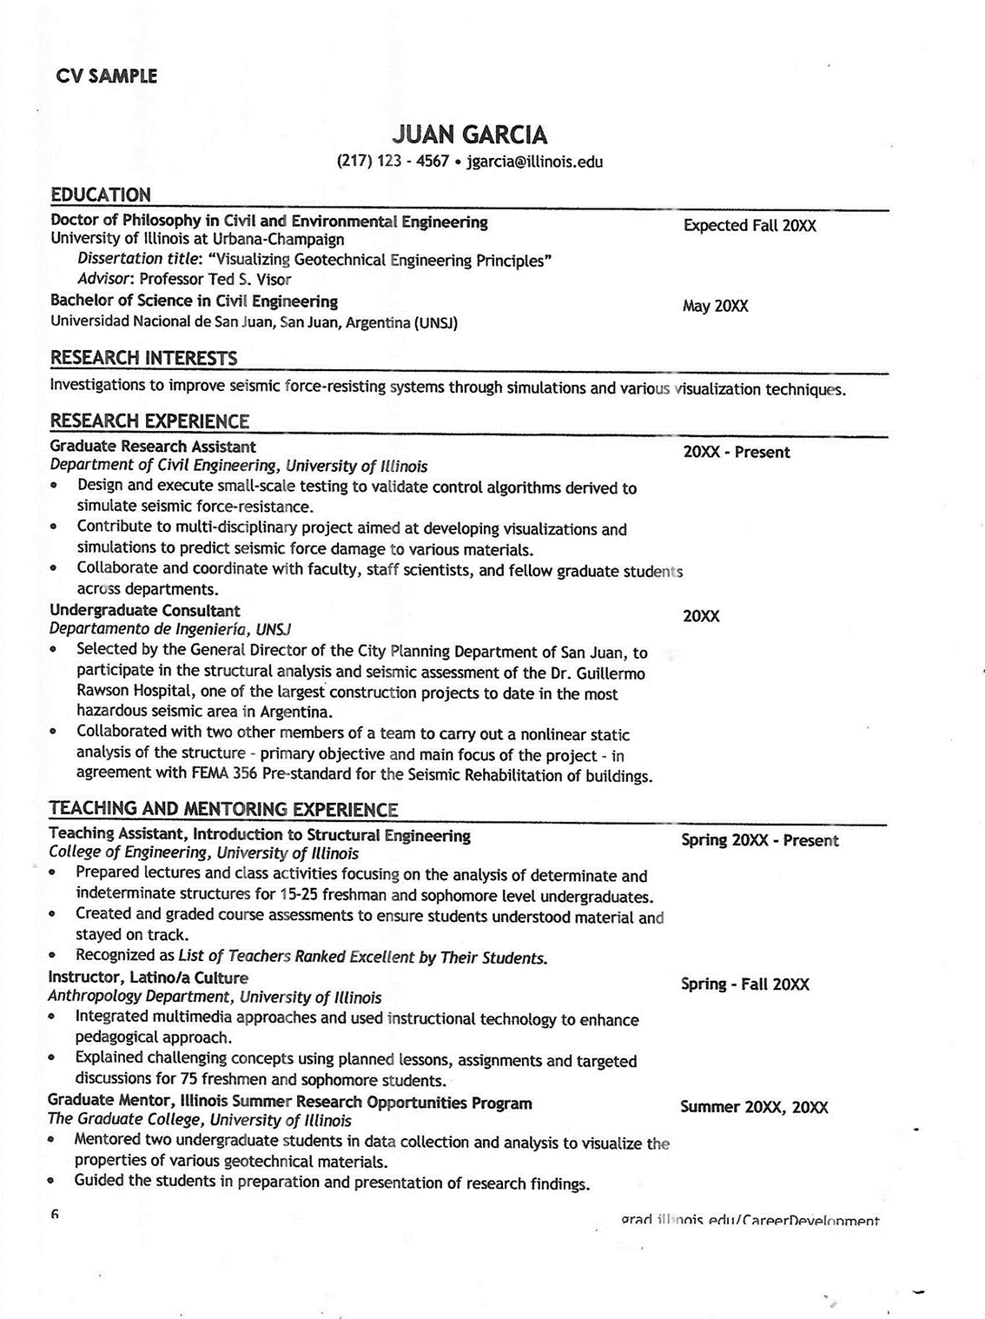
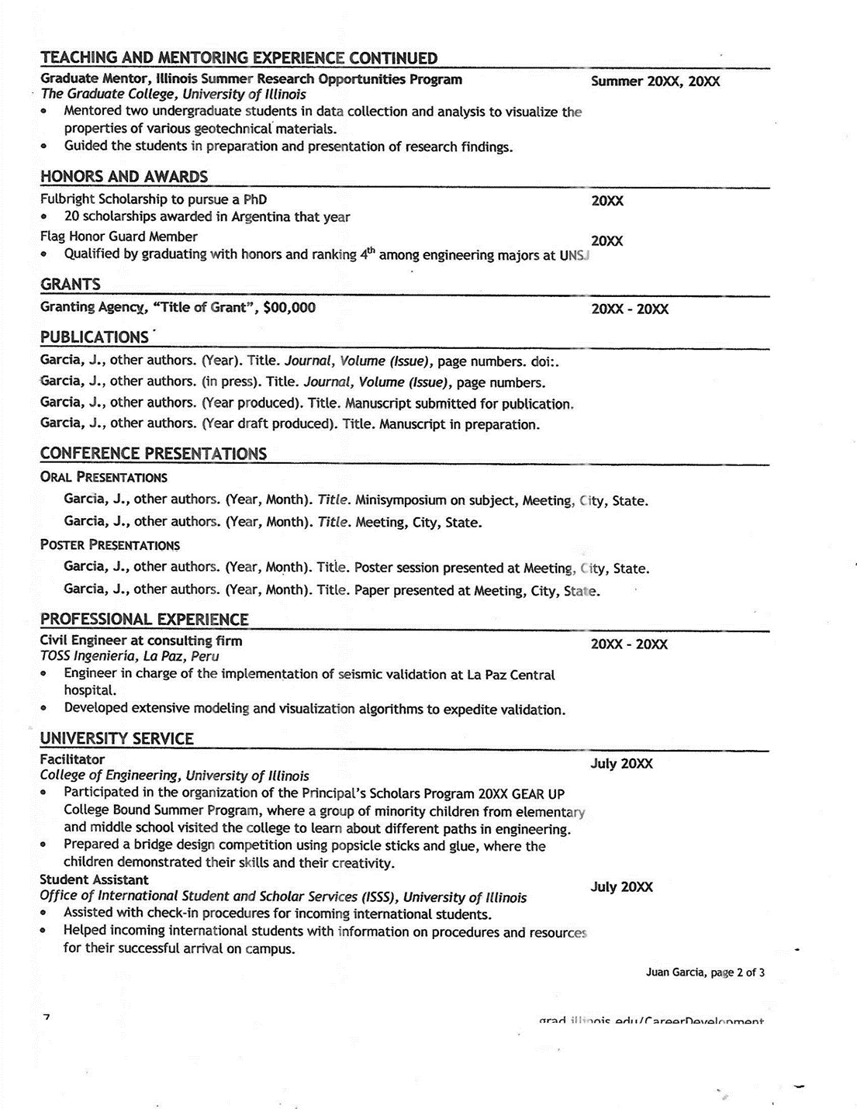
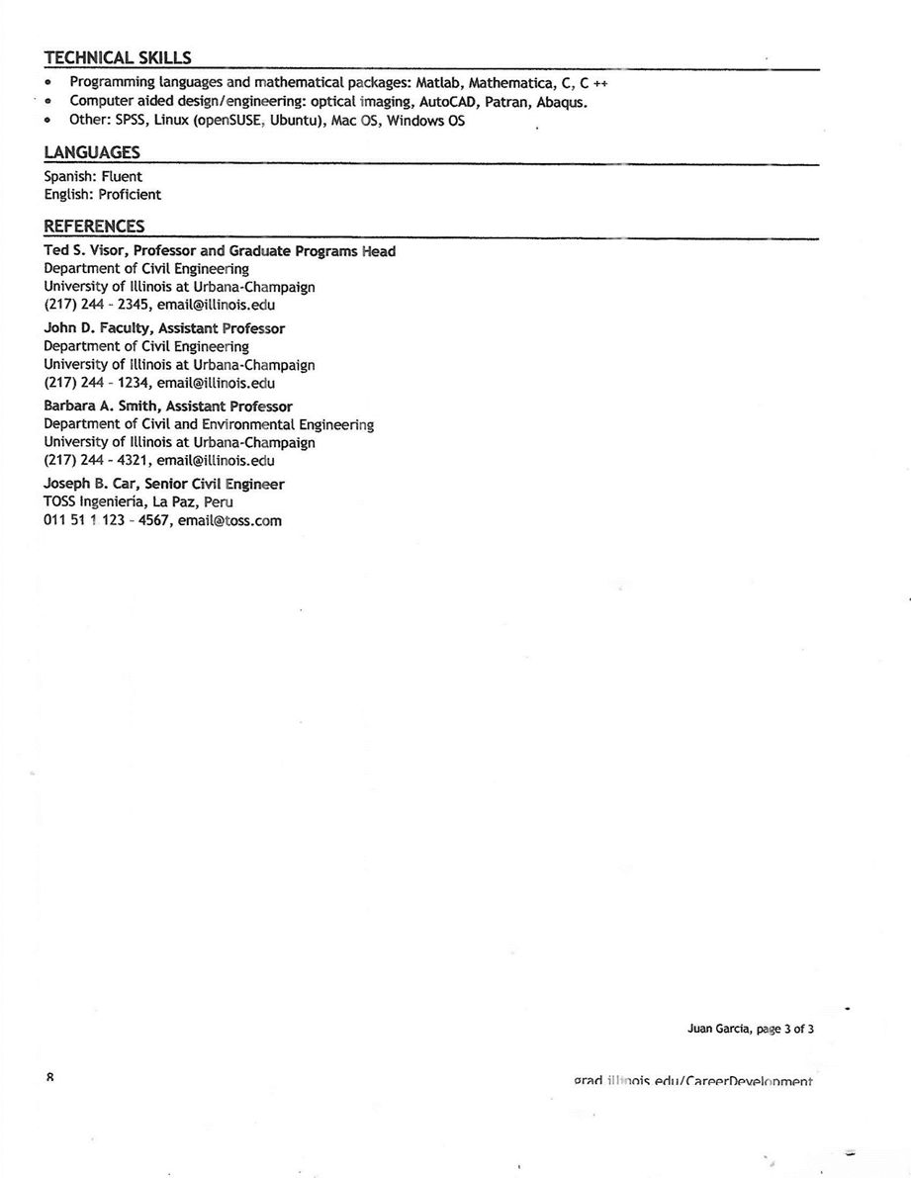
Module 1
Renato: título del segundo apartado de esta sección
1.4.2. Example of a Currículum vitae
Renato: contenido del segundo apartado de esta sección
Click each button to identify the basic components a curriculum must contain.
Aurelio: recrear estas imágenes para presentarlas como imagen guiada con esta información del CV.
.
Personal Information.
Include: Name, address, telephone, date of birth , e-mail. Make sure your name is big and bold and stands out from page.
Certification: Any classes or workshops you have gained a certificate
References: If you create a separate list of references for prospective employers, you can include a phrase such as “References available on request” to signal the end of a résumé, or write “Available on request” Always seek permission from anyone you list as a reference.
Education and qualification: Include years of study and qualifications gained (most recent first, grade achieved, thesis title.Don’t go back any further in time than secondary school.
Achievements:Scholarships
Academic awards,Head boy/ head girl at school, senior prefect,Sporting achievementsMusic grades
Employment History: State dates and relevant places on employment. Include things likethings like health care assistant, nursing home work, team physio, previous physio posts.
Hobbies: This is not very necessary, but if you do it, choose what aspects of your personality you want to emphasize and communicate. Example learning languages, volunteering, writing, etc
Esta nota no tiene flechita porque es una información extra que ellos pueden considerar o no en su curriculum. Puede llevar una etiqueta como : Extra information
Expertas: señalar los elementos que integran el CV, para que Aurelio tenga contenido para la imagen guiada.
Taken from: The Career Development (2014 and Physiopedia).

Slide 13
Module 1
Renato: esta información se presenta con herramienta: pestañas.
Click on each tab to see its content.
Renato: título del primer apartado de esta sección
1.4.3. What is a Resume?
Click the Start button to see the content of the following presentation, there you can find what a resume is and
some recommendations for writing this type of documents are also included.
Renato: contenido del primer apartado de esta sección
Resume
A resume provides a summary of your education, work history, credentials, and other accomplishments and skills. There are also optional sections, including a resume objective and a career summary statement.
Résumés are the most common document requested of applicants in job applications.
A résumé should be as concise as possible. Typically, a résumé is one page long, although sometimes it can be as long as two pages.
Résumés often include bulleted lists to keep information concise.
Résumés come in a few types, including chronological, functional and combination formats. Select a format that best fits the type of job you are applying for.
A résumé is a summary of your background and experience. Its emphasis is on your work experience. A CV is much more comprehensive, providing details about your academic background. Résumés are typically two pages or less, while CVs can be as long as needed to convey your academic background and experience.
CVs are used for academic positions, and the format can vary as long as it includes all the information your prospective employer requires. Résumés are used for most other positions and follow a few standard templates.
(Adapted from Alred, G. et al, 2009, p. 471).
Aurelio: elaborar presentación con esta información.

Slide 14
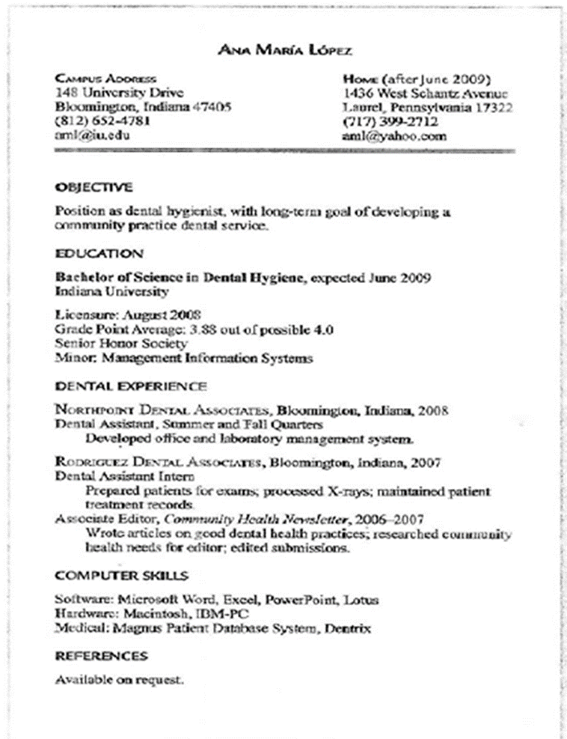
Module 1
Renato: título del segundo apartado de esta sección
1.4.4. Example of a Resume
Renato: contenido del segundo apartado de esta sección
Click each button to identify the components of a resume.
Heading (Contact Information, make sure to include name, address,e-mail. Make sure name is big and bold and stands out from page.
Aurelio: recrear esta imagen para presentarla como imagen guiada.
Qualification Summary: It is a summary of your qualiﬁcations to persuade hiring managers to select you for an interview. It is also called a summary statement or career summary. It includes skills, achievements, experience, or personal qualities that make you especially well suited to the position. You can place it after the contact information.
Job Objective: It helps the reader to understand your goal. If you decide to include an objective, use a heading such as “Objective,” “Employment Objective,” “Career Objective,” or “Job Objective.
Related skills and abilities: You might list in a skills section items such fluency in foreign languages, writing and editing abilities, specialized technical knowledge, or computer skills (including knowledge of speciﬁc languages, software, and hardware).
Education: List the school(s) you have attended, the degree(s) you received and the dates you received them, your major ﬁeld(s) of study, and any academic honors you have earned.
Honor and activities: Include items such as student or community activities, professional or club memberships, awards received, and published works. Be selective
Employment Experience: Organize your employment experience in reverse chronological order, starting with your most recent job and working backward under a single major heading called “Experience,” “Employment,” “Professional Experience,”
(Taken from: Alred, G. et al, 2009, p. 473).
References and Portfolios: If you create a separate list of references for prospective employers, you can include a phrase such as “References available on request” to signal the end of a resume, The portfolio can include successful documents you have written, articles, letters of praise from employers, and copies of awards and certiﬁcates.

Slide 15
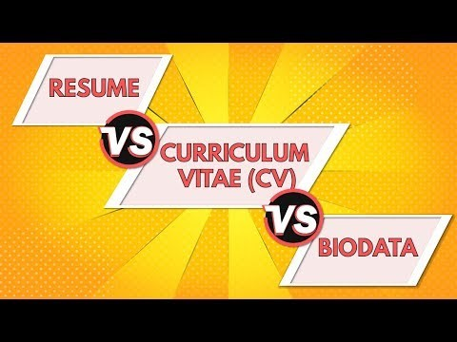
Module 1
Click on each tab to see its content.
Renato: título de sección
1.5. Exercise: curriculum and resume
Renato: título del primer apartado de esta sección
1.5.1. Video: Differences between a curriculum and a resume
Watch the video to check the differences between a curriculum and a resume.
Renato: contenido del primer apartado de esta sección
https://www.youtube.com/watch?v=C85RKXC9dS8

Slide 16

Module 1
Renato: título del segundo apartado de esta sección
1.5.2. Quiz: Differences between a curriculum and a resume
Click the Start button to do the activity. Remember that the score you get in this activity is not considered for your course final grade.
Renato: contenido del segundo apartado de esta sección; colocar el quiz que realice Aurelio.
Aurelio: realizar un quiz en genially con el cuestionario proporcionado por las maestras. Te lo comparto en documento anexo.

Slide 17

Module 1
Renato: título del tercer apartado de esta sección
1.5.3. Write either a Curriculum vitae or a resume
Write either a Curriculum vitae or a résumé in a word document. Pretend you are looking for a job (one you would like to apply or according to your studies) follow the examples given of a curriculum and a Résumé.
Download the following checklist to verify the wording of your document.
Renato: contenido del tercer apartado de esta sección.
Remember that the score you get in this activity is not considered for your course final grade.
Renato: al dar clic en el botón o ícono, se tiene que descargar el documento checklist
Aurelio: dar diseño a la lista de cotejo que proporcionan las maestras para este ejercicio, para ponerlo como documento PDF checklist, que podrán descargar los participantes. Te lo comparto en documento anexo.

Slide 18
Module 1
Click on each tab to see its content.
Renato: título de sección
1.6. Request letter
Renato: título del primer apartado de esta sección
1.6.1. What is a request letter?
Renato: contenido del primer apartado de esta sección
Click the Start button to see the content of the following presentation, there you can find what a request letter is and some recommendations for writing this type of documents are also included.
A request letter is a document in which someone ask for information, a favor or permission for a particular matter, politely. It is an official document that shows the intention of requesting something like a document, details, permission or assistance.
Select Your Introduction
In most cases, it is best to keep the introduction or salutation of the letter as formal as possible. (Address the person by their title, for example Mr, Mrs or Dr with their last name.
While you may have addressed this person by their first name in the past, the situation of formally requesting something in writing often demands a more formal greeting as well. This sets the tone of the letter, so you should give the salutation the attention it deserves.
Be Direct With Your Message
Provide a brief explanation regarding the reason for the letter as well as for the request that you are about to make. For example, you may indicate that services were rendered on a specific date, and invoices where sent on prior dates with no response. Perhaps you were promised information or something else, and now you would like to receive what was promised to you.
Aurelio: elaborar presentación con la información de ésta y la siguiente diapositiva.

Slide 19
Module 1
Include your call to action or request
You should end the body of your letter with a specific call to action or request. For example, you may need information sent to you by a specific date for a project you are working on. Perhaps you need payment by a certain date or the account will be turned over to collections. The tone and wording at the call to action or request should remain professional and civil, and it may even be friendly in nature. Avoid being threatening at all times, even if you are requesting a payment that is past due.
You may accomplish this by offering a phone number for them to call you at to discuss the matter further, or you may offer to drive by their office to pick up information that you are requesting if that is easier for them.
If you are requesting a payment or something that can easily be mailed, you may even include a stamped return envelope to make it more convenient for them to fill the request. Close out your letter with a formal closing and your live signature to authentic it.
Double check your work
Before you send your business request letter, take time to proof read all of your work. If you are concerned about the tone or wording, you may ask a colleague to offer you suggestions for better word choices or sentence structures.
There are times when you want to say something but are unable to structure an approach that is friendly and non-threatening.
Preparing a business request letter is a wonderful way to formally ask for something that you feel is necessary or even owed to you.
Taken from: Bradley, A. (2022).

Slide 20
Module 1
Renato: título del segundo apartado de esta sección
1.6.2. Example of a request letter
Look at the following image that shows the request letter elements.
Dear Harry Clarkson [Name of Sender] Grant and Clarkson Company [Business Name of Sender] Great Clarendon street [Address of Sender] Oxford 25664 [City, State, Zip Code] September 17, 2020 [DATE] Susan Thompson [Name of Person who owes payment] South Road 64654 [Address of Person who owes payment [Bristol, England [City, State, Zip Code] Re: [First reminder for overdue payment] Dear Mrs Thompson This letter is to formally notify you that the payment owed by you on invoice number [NUMBER] is two weeks overdue. The amount of [AMOUNT] was due on [DATE]. I have enclosed a stamped and addressed envelope for you to send the amount by check along with your account number when you receive this letter. The invoice can also be paid by credit card or PayPal. Enclosed is a copy of the invoice that was sent to you with the date and amount due highlighted. One month after the due date, a late fee will be applied to your bill and a new invoice will be sent. If you have already paid this invoice, please disregard this letter. Otherwise, please send the payment immediately. Thank you for your attention to this matter. Sincerely, [Signature of Sender] [Printed Name of Sender]
Renato: contenido del segundo apartado de esta sección.
Aurelio: recrear esta imagen, de manera que se pueda presentar como imagen guiada.
Taken from: Bradley, A. (2022).

Slide 21

Module 1
Click on each tab to see its content.
Renato: título de sección
1.7. Complain letter
Renato: título del primer apartado de esta sección
1.7.1. What is a complain letter?
Renato: contenido del primer apartado de esta sección
Look at the following infographic about a complaint letter and its components.
What is a complain letter?
A complaint letter (or e-mail) describes a problem that the writer requests the recipient to solve. The tone of a complaint letter or e-mail is important; the most effective ones do not sound complaining. If your message reflects only your annoyance and anger, you may not be taken seriously.
Effective complaint letters generally follow this pattern:
1. Identify the problem or faulty item(s) and include relevant invoice numbers, part names, and dates.
2. Include a copy of the receipt, bill, or contract, and keep the original for your records.
3. Explain logically, clearly, and specifically what went wrong, especially for a problem with a service.
4.State what you expect the reader to do to solve the problem.
5. Begin by checking if the company’s Web site provides instructions for submitting a complaint.
6. Finally, you may find that sending copies of a complaint letter to more than one person in the company will get faster results.
Aurelio: elaborar una infografía con esta información.
Taken from Alread et al. (2009)

Slide 22
Module 1
Renato: título del segundo apartado de esta sección
1.7.2. Example of a Complain Letter buscar)
Click on each button to see the components of a complain letter.
Dear Harry Clarkson Grant and Clarkson Company Great Clarendon Street Oxford 25664 Susan Thompson South Road 64654 Bristol, England September 15, 2020 Dear Mr Clarkson Thank you for your delivery of “Swinger” dresses, which we ordered on September 1st. However, we wish to draw your attention to two matters. Of the red dresses supplied, one lot of 100 (size 12) included clothes of a lighter red than the other sizes. Since we deliver a collection of various sizes to each store, it would be obvious to customers that the clothes are dissimilar. In addition the red belt supplied does not match these dresses. We are returning two of these by separate mail, and would ask you to replace the whole lot by 100 dresses size 12 in the correct color. As far as your charges for air freight are concerned, we agreed to pay the extra costs which you invoiced. However, your costs for packing and insurance must have been lower for air cargo, and we request to take this fact into consideration and to make an adjustment to the invoice amount. Would you please send us a rectified invoice, reduce accordingly. We look forward to your dealing with these questions without delay. Very truly yours, Susan Thompson
Renato: contenido del segundo apartado de esta sección
Aurelio: recrear esta imagen para presentarla como imagen guiada. En documento anexo te comparto el esquema completo que realizaron las maestras.
(Taken from: Naterop, J. et al, 1998, p. 56.

Slide 23
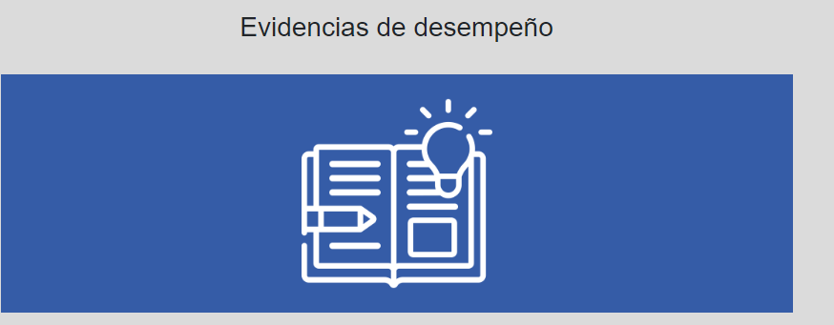
Evidence
Module 1
Project 1:
Request letter and a complain letter.
Click on the icon to see the description of this module evidence.
Description: Course participants write a request and a complain letter following this type of documentation conventions.
Evaluation criteria:
The document must:
Have clarity of purpose and thought.
Convey accurate, relevant and complete information.
Have short, concise and clear sentences.
Have correct grammar and sentence structure.
Guidelines:
The document must be written correctly using samples of the vocabulary and structures studied in this module. It must be written in Microsoft Word using font Arial size 12 and must be sent in an attachment.
Name your file as follows: Actn_LastName and FirstName. For example: Act2_VillanuevaMariaTeresa.
Send your file, in Word format, via Activities tool in Eminus platform, no later than the due date set in the Course calendar.

Slide 24
Module 1
References
Click on each link to look up the references.
Basic reference
Alred, G., Brusaw, C. T. & Oliu, W. E. (2009). Handbook of Technical writing. Ninth edition. APA Updates.
Bradley, A. (2022, june 1). Writing a Business Request Letter [Free Sample]. The writing center. https://writingcenter.unc.edu/tips-and-tools/business-letters/
Career Development. (2014, june). Curriculum vitae. Tips and samples. Grad.illinois.edu. https://grad.illinois.edu/sites/default/files/pdfs/cvsamples.pdf
Naterop, J. B., Weis, E. & Haberfellner, E. (1998). Business Letters for All. 21st edition. Oxford University Press.
SampleTemplates. (S. f.). FREE 5+ Sample Employee Reference Letter Templates in PDF | MS. Sampletemplates.com. https://www.sampletemplates.com/letter-templates/employee-reference-letters.html
The Writing Centre. University of North Carolina at Chapel Hill. Business Writing. What this handout is about.
Writingcenter.unc.edu. https://writingcenter.unc.edu/tips-and-tools/business-letters/
Additional references
Physiopedia. (S. f.) Components of a Good CV. Physio-pedia.com. https://www.physio-pedia.com/Components_of_a_Good_CV
Rosenberg, D. (2020, july 19). What is a Curriculum Vitae (CV)? Thebalancecareers.com. https://www.thebalancecareers.com/curriculum-vitae-526158

